Slide 1
Introduction

Slide 2
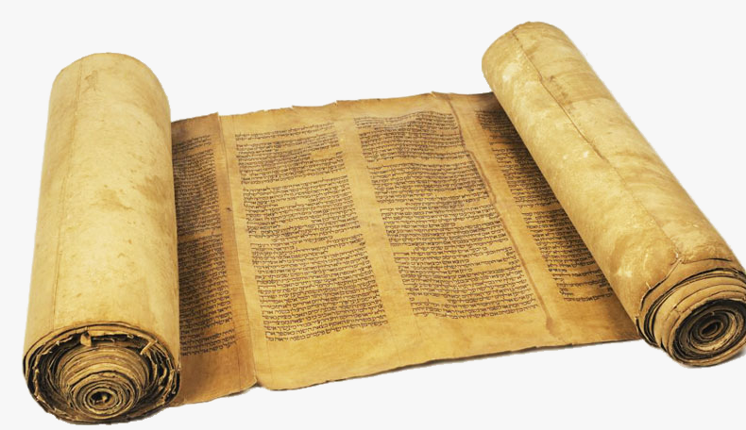
New Testament
New Testament consists of 27 books
OT covers 1500 years, NT 70 years
New Testament means “new covenant”
Old Covenant-Forgive sins provisionally by animal sacrifices
New Covenant-Jesus made possible full remission of sin

Slide 3
The Writings
Written in Greek AD 45-95
Authors: Apostles (Matthew, John, Paul, and Peter)
Associates: Mark, Luke, James, and Jude
Not in chronological order
Paul’s letters first (not in order)
Mark was first gospel written

Slide 4
Why Study the NT?
Historical reason - explains Christianity
Cultural reason - NT has permeated Western and to some degree global civilization
Theological reason - NT consists of divinely inspired accounts and interpretations of Jesus’ redemptive mission and forms the standard of belief and practice for the Christian church

Slide 5
Biggest Barriers to Reading NT
1) Not having enough time
2) Lacking motivation and discipline
3) Feeling intimidated
4) Struggling to apply the Bible to everyday life

Slide 6
Biggest Barriers to Reading NT
1) Not having enough time/make it a priority
2) Lacking motivation and discipline/just do it
3) Feeling intimidated/gradual process
4) Struggling to apply the Bible to everyday life/depend on the spirit to lead

